Slide 1

Stress Neurocircuitry & Airway Inflammation in Asthma
Estelle Higgins, William Busse, Stephane Esnault, Danika Klaus, Melissa Rosenkranz
University of Wisconsin-Madison

Slide 2
Background

Slide 3



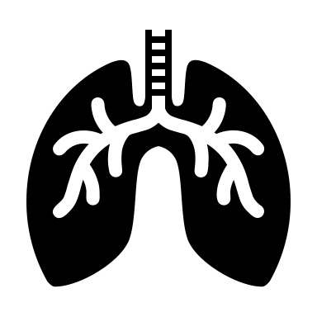
Background
descending pathways
stress
airway inflammation
Initial evidence:
Emotion neurocircuitry & inflammation
Th17 cells (IL-1β/IL-17 pathways), asthma, & psychological distress
Powerpower stock images;
https://www.insperity.com/blog/life-stressors/
Notes:
To start off, the brain is a key player in the bidirectional relationships among psychological stress, descending biological pathways, and airway inflammation in asthma
Well-known that psychological stress can worsen asthma symptoms, control, and treatment responses…
However, there is a considerable gap in understanding (NEXT) which brain regions are involved, and (NEXT) which descending pathways are most important [for these relationships]
(NEXT) Initial evidence, including prior work from our lab, points to
Emotion-related neurocircuitry … inflammation
Th17 cells including IL1b/IL17 pathways which have shown involvement in BOTH asthmatic inflammation AND stress, depression, anxiety

Slide 4
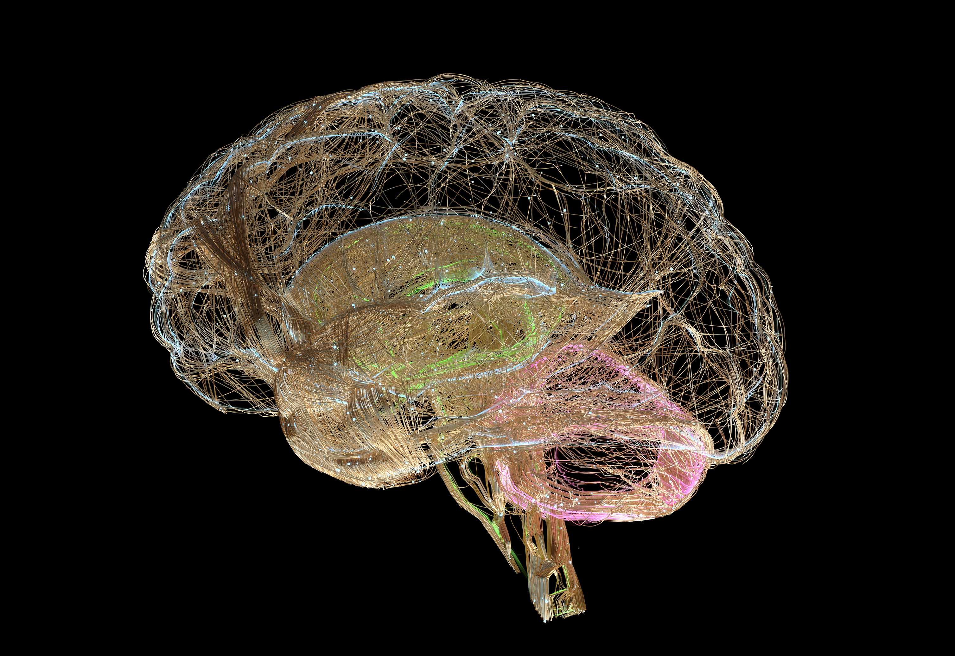

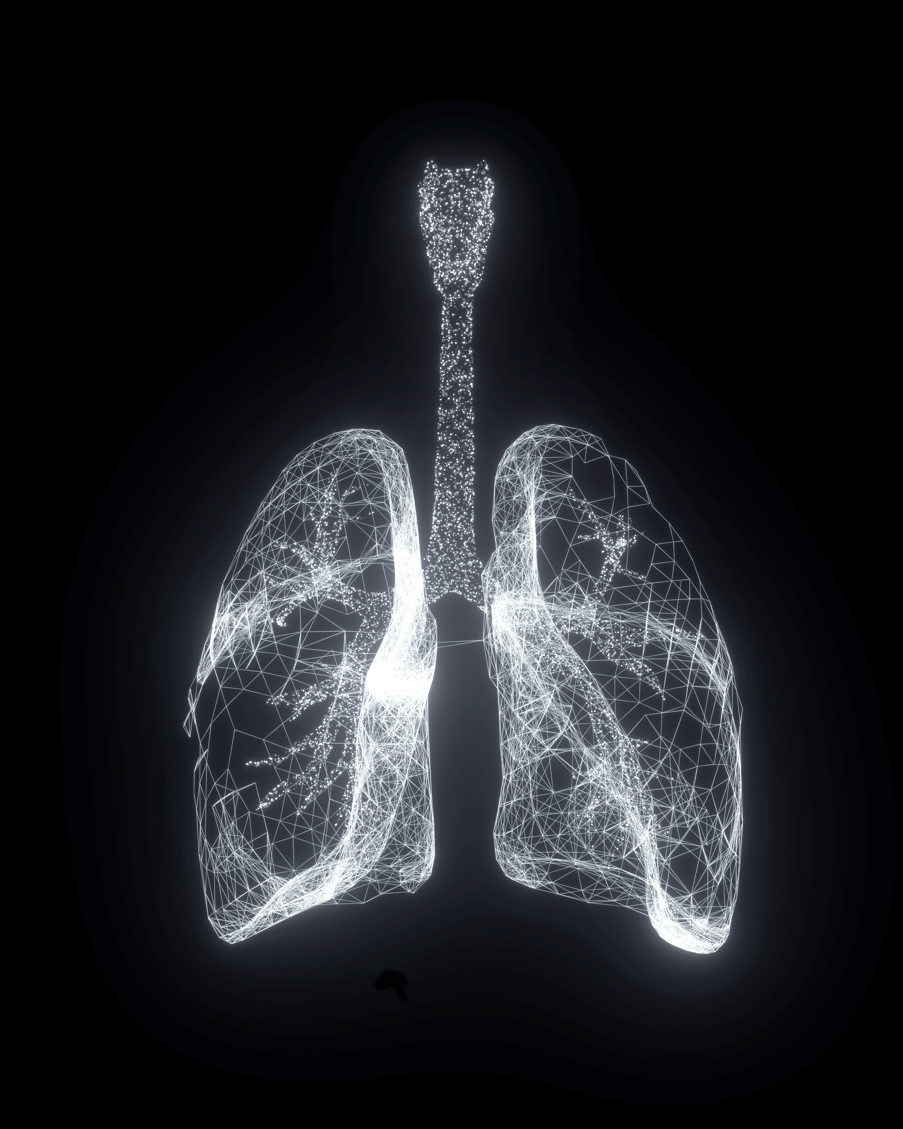
Hypotheses
Psychosocial Stressor
Stress Neurocircuitry
Allergen Challenge
Efferent Pathway
Inflammation
Asthma-Related Th2 & Th17 Pathways
Powerpower stock images
Notes:
So, in this study we hypothesized that a psychosocial stressor would activate stress neurocircuitry, [NEXT] which would influence the production and release of asthma-related Th2 and/or Th17 immune cells. We hypothesized that this priming would increase susceptibility, so that a subsequent allergen challenge [NEXT] would cause a more severe inflammatory response following stress compared to control

Slide 5
Study Design

Slide 6
Study Design
Day 1: Baseline **
Day 2: Challenge **
Psychosocial Stress or
Control Task
PET Brain Scan
Acute Lung Allergen Challenge
30min
30min
Salivary Cortisol Collected
Lung Function & Inflammation Measured
X 2
Day 3: Follow-Up **
** Airway inflammation measured (daily)
Notes:
Brief overview of the study design: each visit consisted of 3 days which began with a day of baseline measures. [next] Day 2 contained the experimental manipulations, beginining with a psychosocial stress task OR a non-stressful control task followed by a PET brain scan. We collected salivary cortisol during the stress or control task and brain scan. Then participants were given an acute airway allergen challenge, before and after which we measured lung function and inflammation. [next] Finally, participants came back ~24hr later to get follow-up lung function and inflammation measures. [next]
Each person did this twice – once with the stress condition and once with the control condition

Slide 7
Results

Slide 8
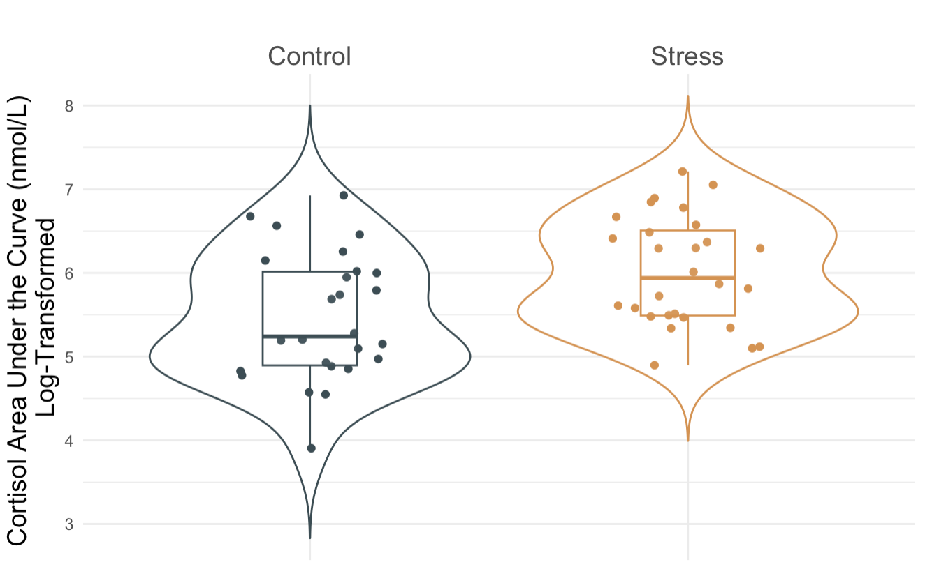
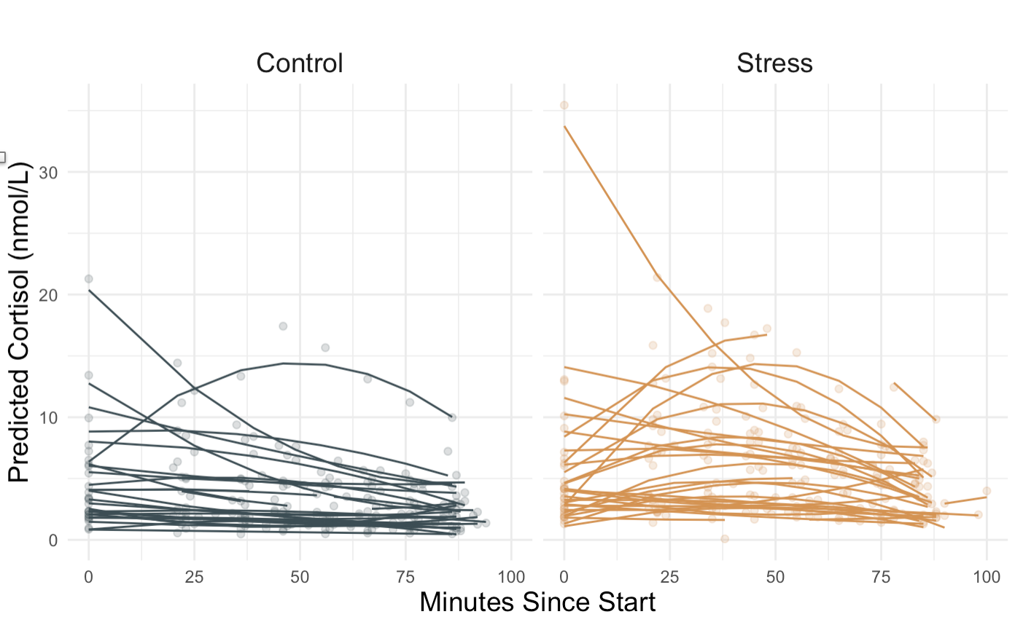
Acute Stress Increases Cortisol
t(27) = 3, p = .005
t(27) = -2.78, p = .01
Notes:
As expected, we found that overall cortisol output (captured by area under the curve) was significantly greater in the stress condition.
Additionally, we showed that there was a pattern in this difference between stres and control, such that cortisol levels increased (reflecting a stress reactivity) and then decreased (like stress recovery) in the stress condition, but showed no pattern in the control condition
OUTLIERS?
1013 is the control one who looks like a stress response; 1054 is the one w the super high baseline stress cort
subject who had 4 or more samples >3sd from the mean, within-condition (stress, control): ➔ this identified 1029 control, 1085 stress, but NOT 1054 baseline stress (which was not an outlier according to 3sd from the mean across or within condition, or within subject)

Slide 9
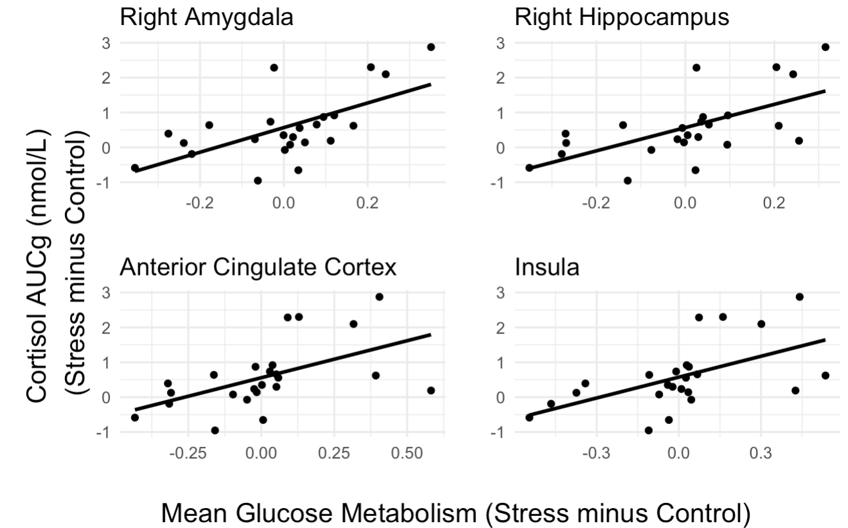
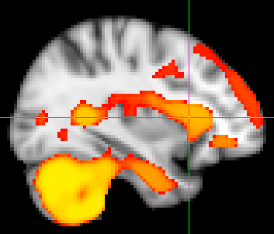
Cortisol Response to Stress is Associated with Stress Neurocircuitry Activation
p < .05 corrected
Greater glucose metabolism, in stress vs control
Notes:
In the brain, we found that the cortisol response to stress was associated with greater brain activation in stress- and emotion-related regions, including in the bilateral amygdalae and HPC, anterior cingulate cortex, insula, and cerebellum in the stress, relative to control, condition

Slide 10
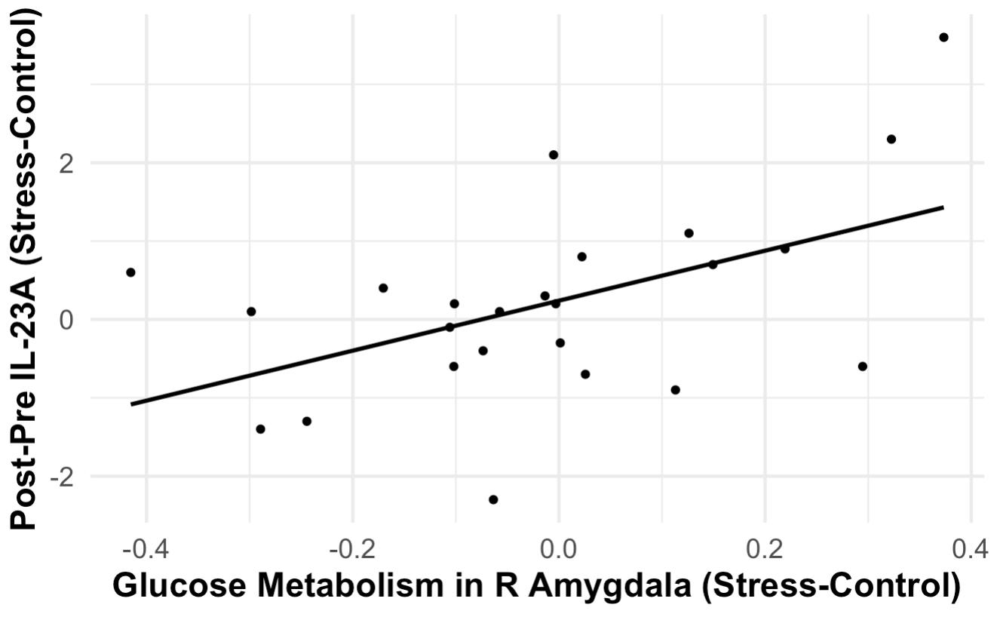
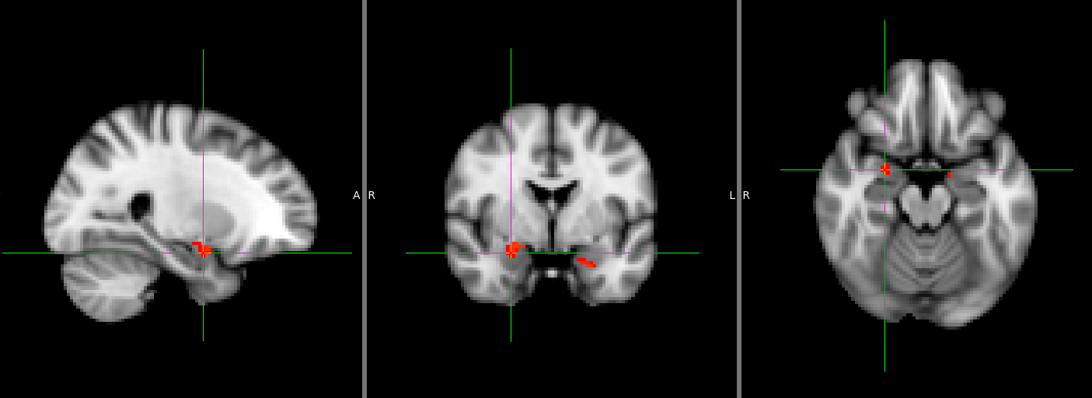
IL-23A Expression Post-Airway Challenge Increase is Associated with Stress-Related Amygdala Activation
Greater increase in inflammation,
in stress vs control
p < .05 corrected
Greater glucose metabolism, in stress vs control
Notes:
Importantly, we found that IL23A mRNA expression in response to the airway challenge was positively associated with stress-related amygdala activation. This means that greater increase in this Th17-related inflammatory marker following the airway challenge was associated with more activation in the amygdala in the stress, relative to control, condition

Slide 11
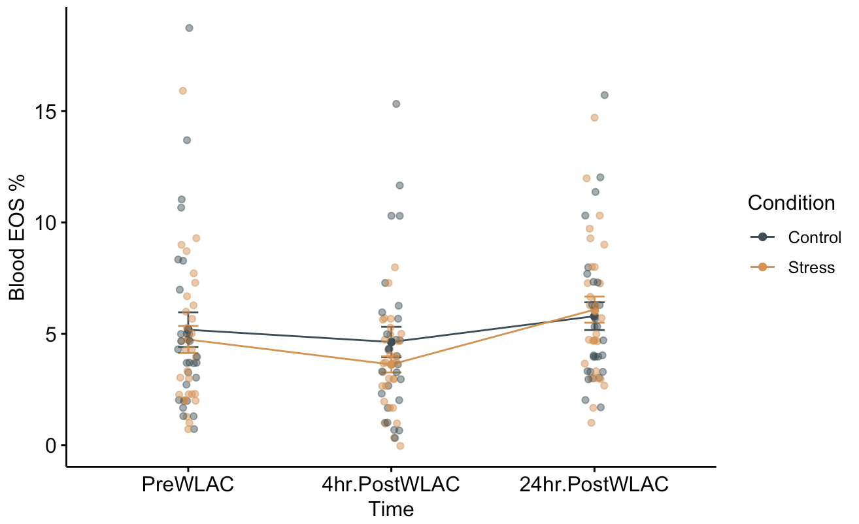
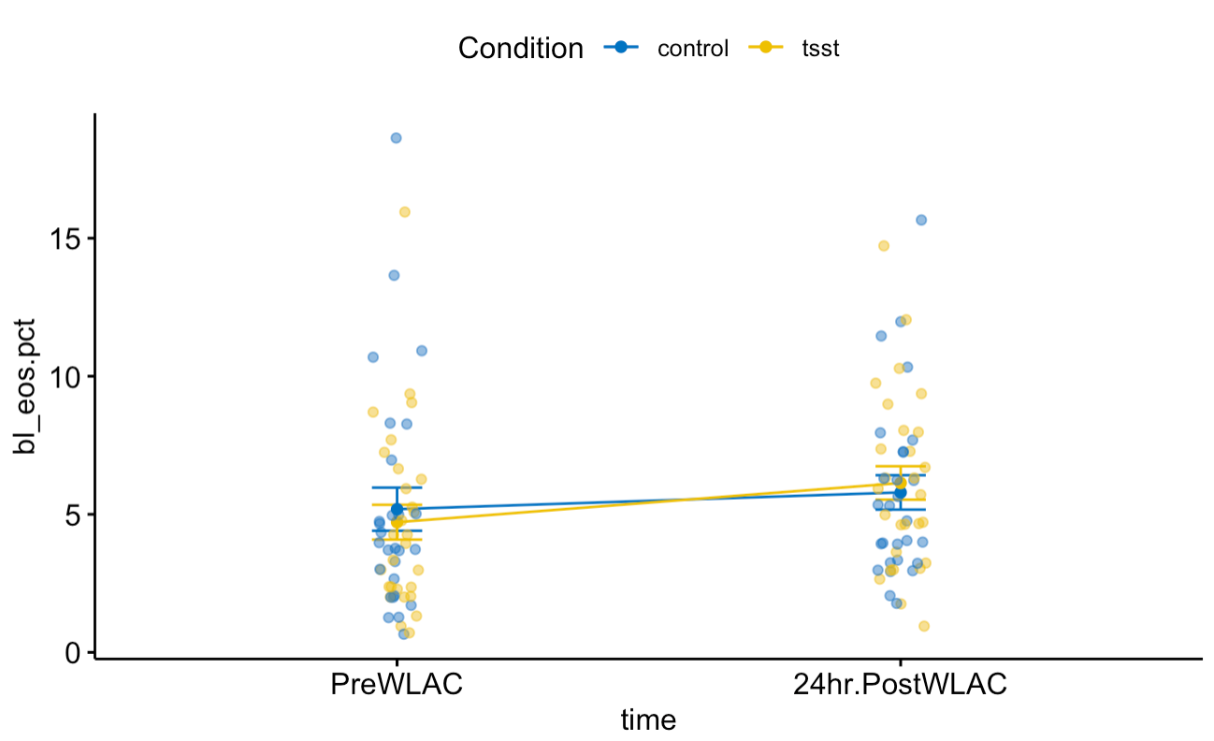
Results: Allergen Challenge Increases Inflammation
Allergen challenge increases blood eosinophils (EOS); more for those who were stressed
Notes:
Significant increase in blood eos across groups, AND in stress group but not control group but that difference (interac) is not significant
In TSST group, significant decrease from 24hr pre to 4hr post; significant increase from 4hr to 24hr post
In control group, no significant change from 24hr pre to 4hr post; and increase from 4hr to 24hr post
But the group difference was only significant/marginal for 4hr to 24hr post
*** from 4hr postWLAC to 24hrpostWLAC, significant condition diff (paired t.test of diff score ~ condition); t(27) = -2.12, p = .043 where the stress condition diff score is greater than the control diff score (bigger diff = greater increase) – LMEM marginal interaction t(28) = -1.984, p = 0.0572 for dichotomous time…
*** from 24hr preWLAC to 24hrpostWLAC, no significant condition diff ; but significant effect of time
*** 24hr pre to 4hr post?

Slide 12
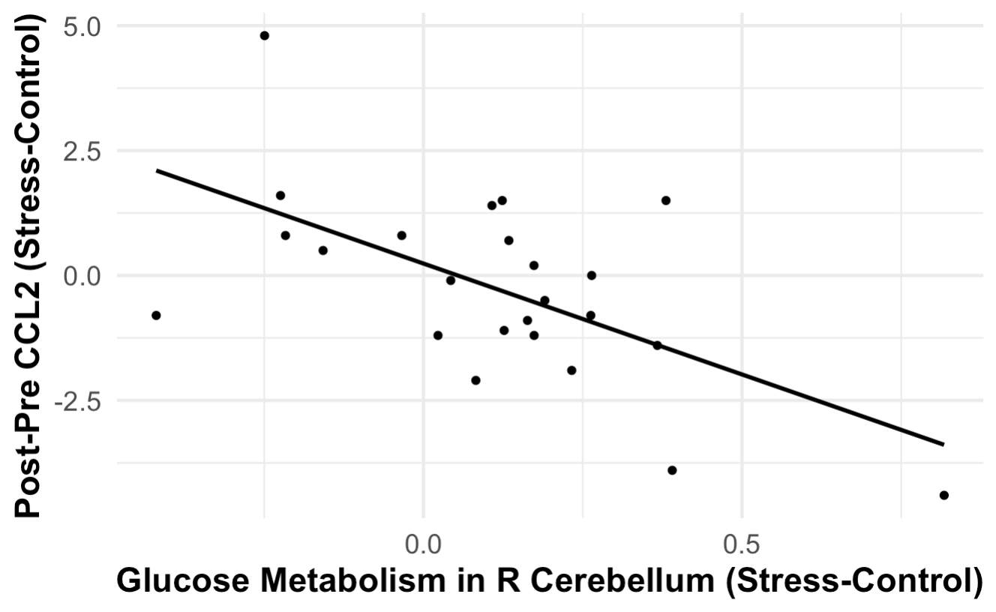
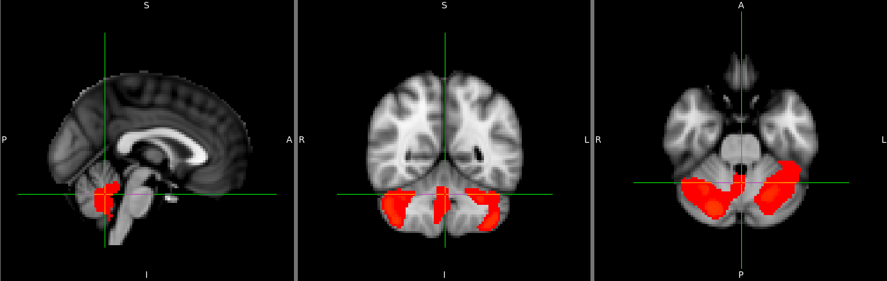
CCL2 Increase After WL-AG is Associated with Decreased Cerebellum Activation
Greater increase in inflammation,
in stress vs control
p < .01 corrected
Greater glucose metabolism, in stress vs control
Notes:
Whole brain: increased inflammation following allergen challenge is correlated w less cerebellum activation in stress relative to control conditions

Slide 13
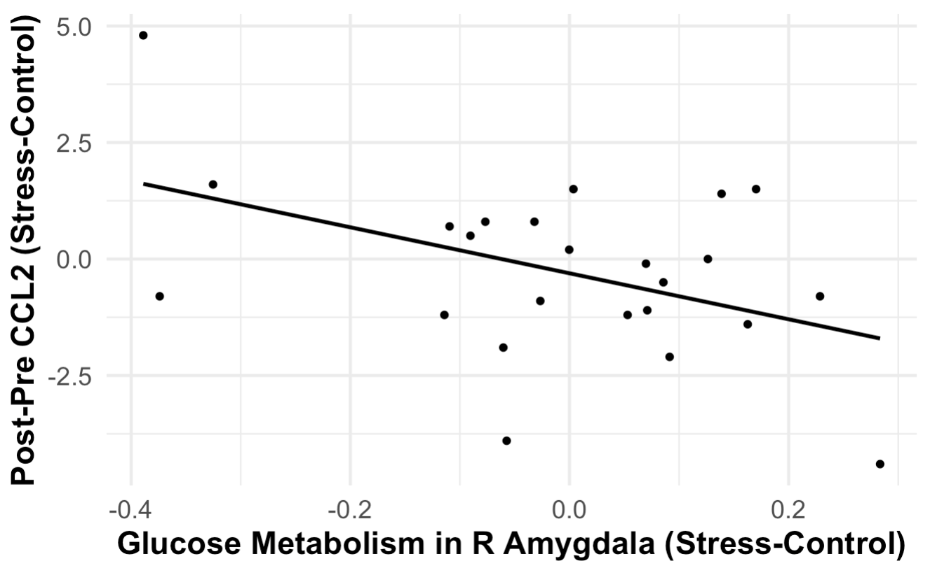
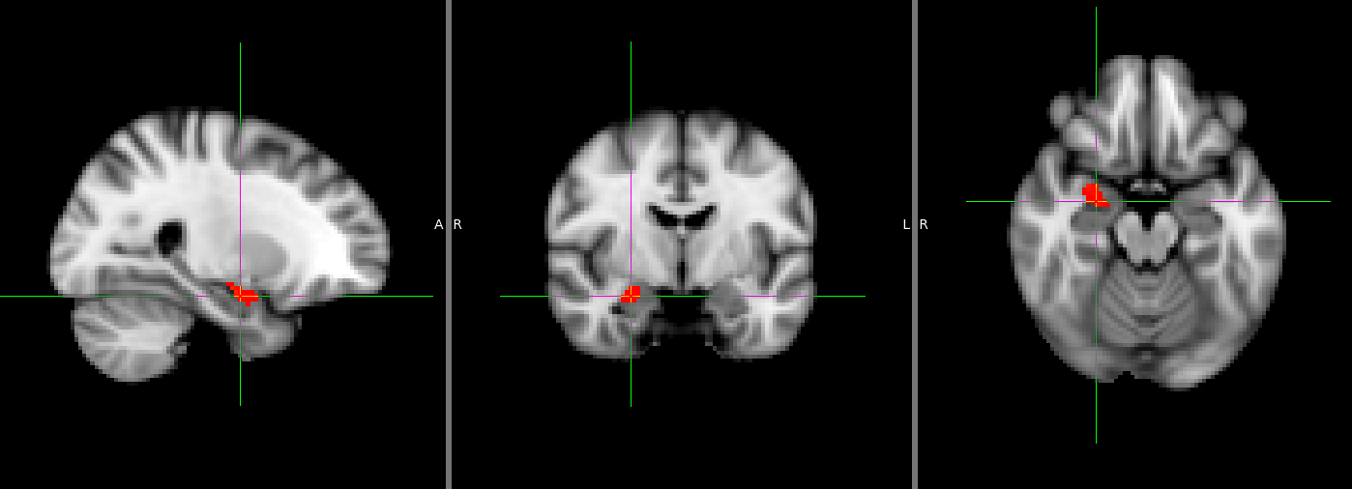
CCL2 Increase After WL-AG is Associated with Decreased Amygdala Activation
Greater increase in inflammation,
in stress vs control
p < .05 corrected
Greater glucose metabolism, in stress vs control
Notes:
Amygdala ROI : greater increase in IL-23A (response to allergen challenge) associated with MORE amygdala glucose metabolism, in stress vs control -- bilateral

Slide 14
Conclusions

Slide 15
Conclusions
Psychosocial stress-evoked cortisol associated with brain activity (amygdala, hippocampus, ACC, insula)
Greater Th17-related (IL-23A mRNA) inflammatory response to allergen associated with increased stress-related amygdala activity
Stress-related brain activity predicts increased inflammatory signaling capacity
Efferent pathway
Targeted treatments
Notes:
Overall, we showed that psychosocial stress-evoked cortisol was associated with brain activation in stress- and emotion-responsive regions
AND, greater Th17-related inflammatory response (IL23A) to allergen was associated with increased stress-related amygdala activation
These results provide initial support for our hypothesis that stress-related brain activity predicts increased inflammatory signaling capacity
Important caveat though is that analyses are still in progress! - but -
efferent pathway connecting emotion/stress to inflammatory responses in asthma [arm of brain-lung axis]
Understanding the mechanisms connecting psychological stress, the brain, and asthmatic inflammation could help in developing more targeted, personalized treatments with peripheral and/or central targets

Slide 16







Thank You!
Richard Davidson, PhD
Melissa Rosenkranz, PhD
William Busse, PhD
Stephane Esnault, PhD
Work supported by NHLBI (R01 HL123284)
Danika Klaus, RN
…and many more!
Notes:
Thank you to the extraordinary team that made this work possible!

Slide 17
Questions

Slide 18
Questions

Slide 19
Questions

Slide 20
Th17 Cells
Adaptive Immune System → IL-17 (neutrophils)
Differentiation promoted by IL-23, TNF-a, IL-1β, IL-21 (requires IL-6 and TGFβ)
Psychological Stress → ↑ IL-23A, IL-1β, IL-6
Asthma:
IL-17 in severe asthma; modulates Th2 responses in mild asthma
EOS (Th2 cells) release IL-1β → IL-17 expression
Notes:
Th17 cells are a subpopulation of adaptive/humoral immune system; they produce IL17 (linked to neutrophils, important in some asthma)
Th17 cell differentiation is promoted by IL23, TNFa, ILb1, IL21; requires IL-6 and TGF beta
Psychological stress leads to increases in cytokines driving Th17 cell production including IL23A, IL1b, and IL6 in both animals and humans
In ASTHMA:
IL-17 often associated w severe asthma; but has been shown to modulate Th2 responses in mild asthma
EOS (canonical Th2 cells in asthma) have been shown to release IL-1β which increased expression of IL-17A in CD4+ cells
AND this type of asthma is often non-responsive to steroid treatment which is the gold-standard/first-line treatment

Slide 21
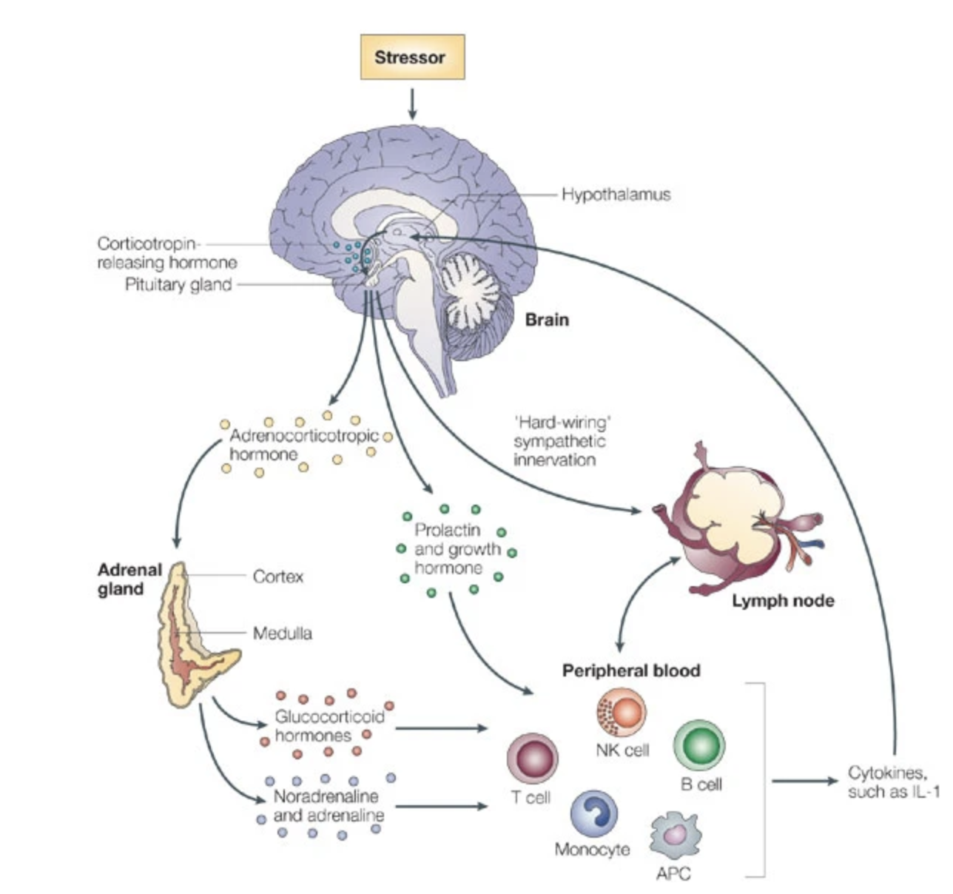


How does the brain influence the airway?
Distal Mechanism: brain (sub/cortical)
In-Between Mechanisms: brainstem
Proximal Mechanisms:
HPA Axis
Sympathetic Nervous System
Neurogenic Inflammation (Sensory Neuropeptides)
(Glaser & Kiecolt-Glaser, 2005)
Notes:
HOW does increased glucose metabolism actually lead to increases airway response to allergen?
Distal mechanism: neural activity (emotion-related cortical/subcortical regions)
“In-between” mechanisms include regions like the brainstem
These regions are linked to ANS control centers and HPA axis regulation
HPA axis: glucocorticoids impacting immune cells – suppress in short term, contribute to inflammation in long term (e.g., what we saw w chronic stress in first study)
SNS: innervation of lymph nodes; circulating catecholamines bias to promote asthma-related inflammation
Neurogenic inflammation via sensory neuropeptides

Slide 22
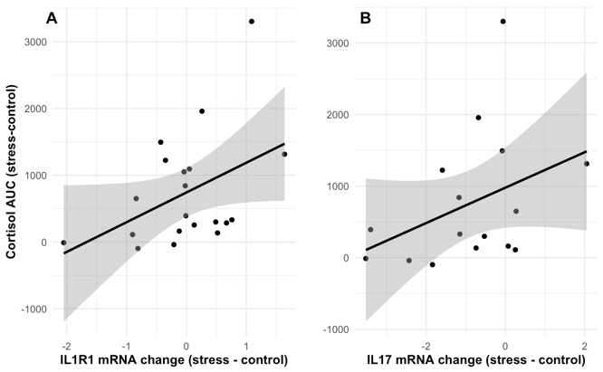
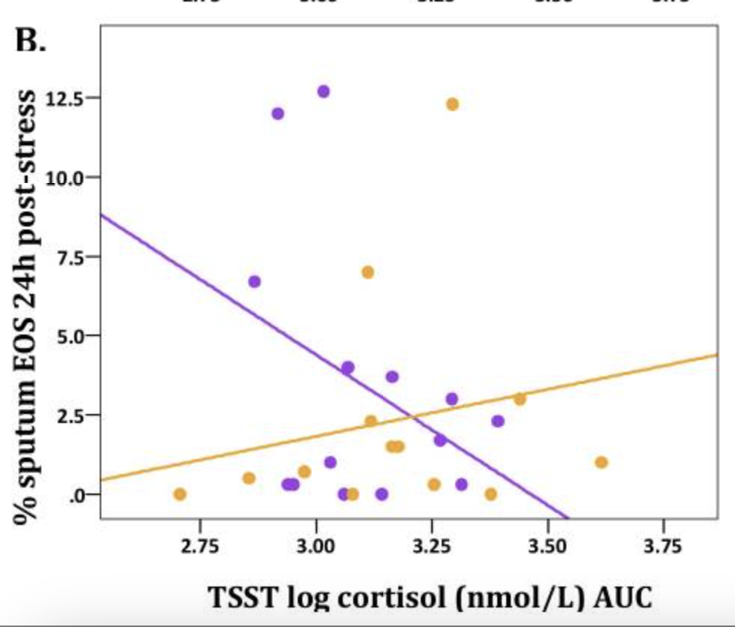

Prior Evidence
Psychosocial Stressor ⟶ Increased Cortisol, associated with Airway Inflammation Biomarkers
Th17 path (IL-17A, IL-1R1) - Th2 path (EOS) moderated by chronic stress
greater airway
inflammation
(Rosenkranz et al., 2016)
greater cortisol
Notes:
Main motivation for this study came from our prior work implying the that a context of stress primes susceptibility to more severe inflammatory responses :
We found that a psychosocial stressor increased salivary cortisol, which was associated with airway inflammation biomarkers:
In the Th17 path, cortisol response to the TSST positively associated with expression of IL-17A and IL-1R1 mRNA in airway cells.
Note here this is mRNA, not actual protein expression: = body is prepared to respond
IL-1R1 = receptor for IL-1b
Inflammation in the Th2 path (eosinophils) was moderated by chronic stress levels, such that [next]
Cortisol response to acute stress and sputum EOS were POSITIVELY associated for those with high baseline chronic stress (yellow line), but negatively associated for those with low chronic stress (purple) [next]
Disparate effects of cortisol on airway inflammation, depending on chronic stress
Importantly, this was found in the absence of airway challenge! [next]
Higher chronic stress also associated with greater cortisol response to TSST

Slide 23
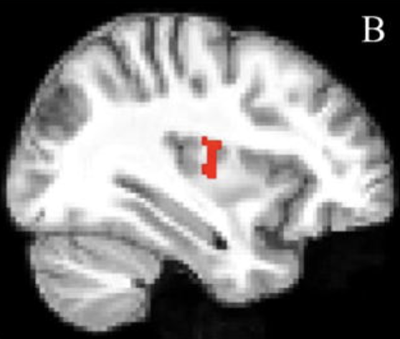
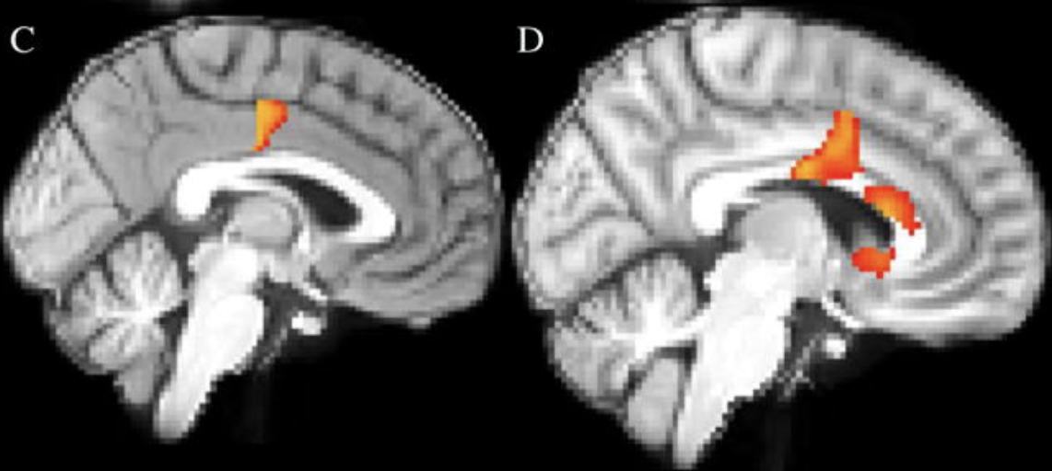
Prior Evidence
Psychosocial Stressor ⟶ Stress Neurocircuitry Activation associated with Airway Inflammation Biomarkers
Th2 pathway (FeNO) & Th17 cell mRNA (IL23A, IL1R1)
IL23A mRNA
IL1R1 mRNA
FeNO
(Rosenkranz et al., 2016)
Notes:
In the brain, we found that the psychosocial stressor resulted in activation of stress neurocircuitry (PET), which was associated with biomarkers of airway inflammation [next]
Again, this was in the absence of airway challenge! [next]
[next] both Th2 pathway and Th17 cytokine mRNA
(Greater insula activation during stress vs control associated w higher FeNO; greater MCC activation during stress vs control predicted IL23A mRNA expression, and greater rostral ACC activation during stress vs control predicted IL1R1 mRNA expression)
EOS can release IL-1b AND stress has been shown to increase IL-1b;
IL-1b causes increased expression IL17, which contributes to asthmatic inflammation
IL-1R1 = IL-1b receptor, measured bc IL-1b measures can’t distinguish betw bio active form and immature isoform
IL-23A also promotes IL17 expression, which contributes to asthmatic inflammation

